Slide 1
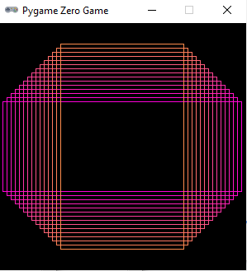

Slide 2

Steps:
Import pgzrun
Provide a width and a height to the pgzero screen

Slide 3
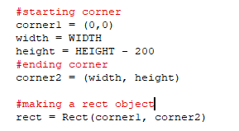
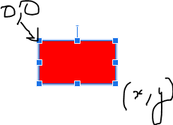
3. Define the draw function
The draw function is the one which is responsible for rendering the animations and graphics
4. Inside the draw function : make a rectangle.
First let us make a rect object, for which we need the 2 corners of the rectangle

Slide 4

To change the screen color

Slide 5
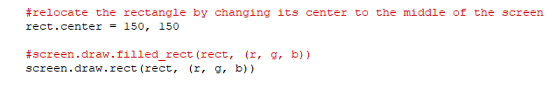
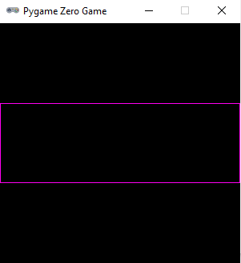

5. Draw the rectangle: but first define a random r, g and b values and call the main loop
For starting the game loop

Slide 6
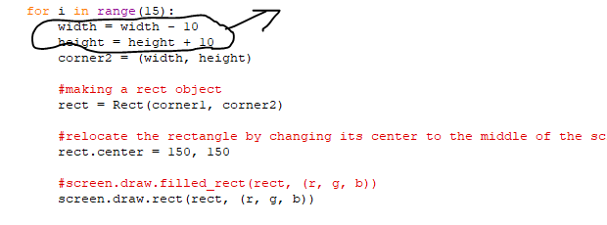
For drawing many rect, create a for loop as above. For the next rectangle, we reduce the with by 10 and increase the height by 10

Slide 7


Optional - adjust the colors, by adjusting the g and b components of the color.
Initial values of the r,g,b components:
Inside the for loop, increase the g part by 10 and reduce the b part by 10

Slide 8
Final Output

Slide 9
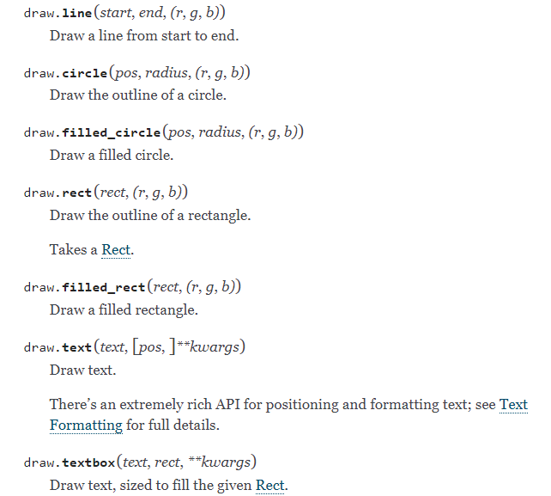

Slide 10
screen.draw.text("Text color", (50, 30), color="orange")
screen.draw.text("Font name and size", (20, 100), fontname="Boogaloo", fontsize=60)
screen.draw.text("Positioned text", topright=(840, 20))
screen.draw.text("Allow me to demonstrate wrapped text.", (90, 210), width=180, lineheight=1.5)
screen.draw.text("Outlined text", (400, 70), owidth=1.5, ocolor=(255,255,0), color=(0,0,0))
screen.draw.text("Drop shadow", (640, 110), shadow=(2,2), scolor="#202020")
screen.draw.text("Color gradient", (540, 170), color="red", gcolor="purple")
screen.draw.text("Transparency", (700, 240), alpha=0.1)
screen.draw.text("Vertical text", midleft=(40, 440), angle=90)
screen.draw.text("All together now:\nCombining the above options",
midbottom=(427,460), width=360, fontname="Boogaloo", fontsize=48,
color="#AAFF00", gcolor="#66AA00", owidth=1.5, ocolor="black", alpha=0.8)

Slide 11
HW
Draw other shapes by looking at the options at:
https://pygame-zero.readthedocs.io/en/stable/builtins.html#screen

